Slide 1
Played by the System
Chaotic Dynamics in Game Theory and death of foresight

Slide 2
Presentation flow diagram
Game Theory Preliminaries
Strategy Evolution
Hamiltonian Dynamics of Games
Chaos!

Slide 3
Game Theory Preliminaries (2-player games)
2 players, with move sets {x₁,x₂,...,x_{n}} and {y₁,y₂,...,y_{m}}
Payoff matrices A and B for players 1 and 2, respectively
In zero-sum games, A = -B^{T}
Players build strategies as a probability distribution over their move sets
Viewing these strategies as vector sums x and y, can plot as points on simplices and get payoffs as xAy^{T} and yBx^{T}.
We look for Nash Equilibria, where no player would change their strategy

Slide 4
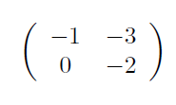
Example: Prisoner’s Dilemma
Movesets are {Cooperate, Betray} for both players
Payoff Matrices are
Cooperation is always worse than betrayal : “dominated”
Player 2
Cooperate
Betray
(-1,-1) | (-3,0)
(0,-3) | (-2,-2)
Cooperate
Player 1
Betray

Slide 5
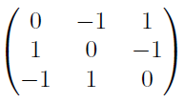

Our example: Rock Paper Scissors
Movesets are {Rock, Paper, Scissors}
Payoff matrices are
Nash Equilibrium at {⅓,⅓,⅓}
But how do we get there?

Slide 6
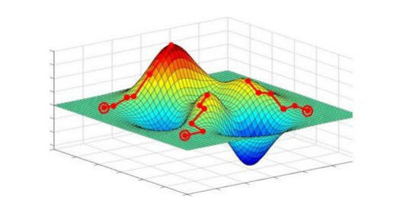

Strategy evolution via Gradient Ascent
Players use Gradient Ascent to improve payoffs

Slide 7


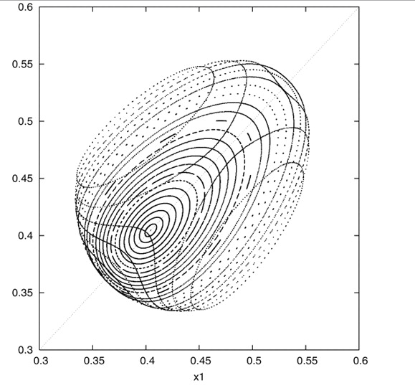


Hamiltonian Dynamics Arise From Gradient Ascent
Hamiltonian structure!
Rescale to stay on simplex:
Strategies evolve along lovely toroidal orbits

Slide 8
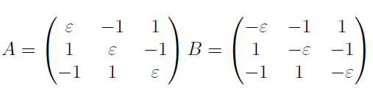
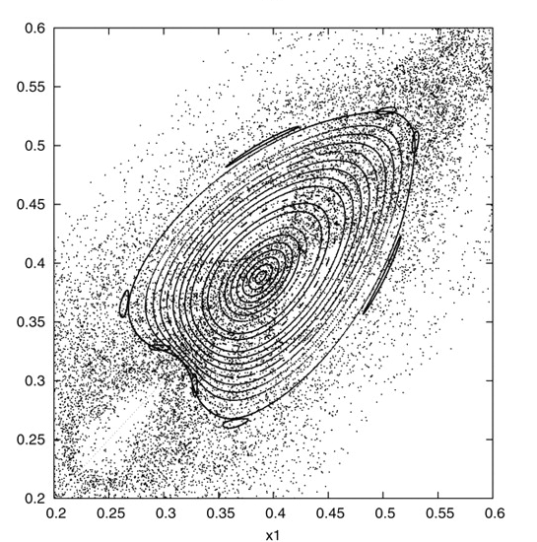
Perturbing simple RPS game can cause Chaos
Change the RPS payoff matrix so that ties are not even
Now toroidal orbits densely interweave with chaotic paths, rendering prediction moot.

Slide 9
References
Hofbauer, Josef, and Karl Sigmund. Evolutionary Games and Population Dynamics. Cambridge: Cambridge UP, 1998. Web.
J. Math. Biol. (1996) 34: 67. J. Math. Biol. (1996) 34: 675—688 Evolutionary Dynamics for Bimatrix Games: A Hamiltonian System? (n.d.): n. pag. Web.
Sato, Y., E. Akiyama, and J. D. Farmer. "Chaos in Learning a Simple Two-person Game." Proceedings of the National Academy of Sciences 99.7 (2002): 4748-751. Web.
Tadelis, Steve. Game Theory: An Introduction. Princeton: Princeton UP, 2013. Print.

